Slide 1
Software Engineering
Dr. Md. Nasim Adnan

Slide 2
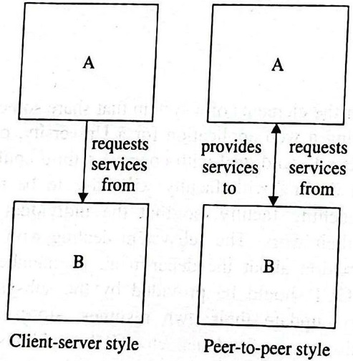
Architectural Modeling

Slide 3
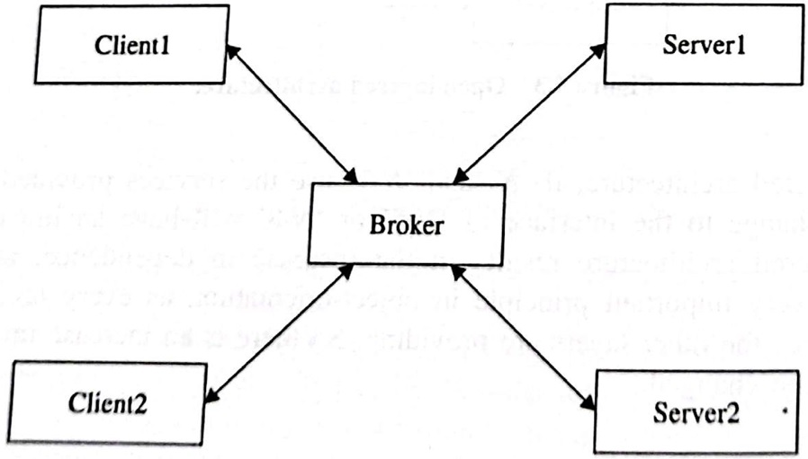

Slide 4
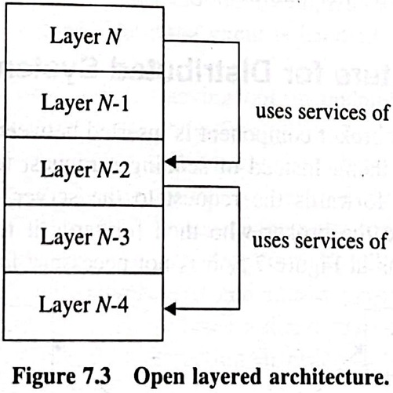
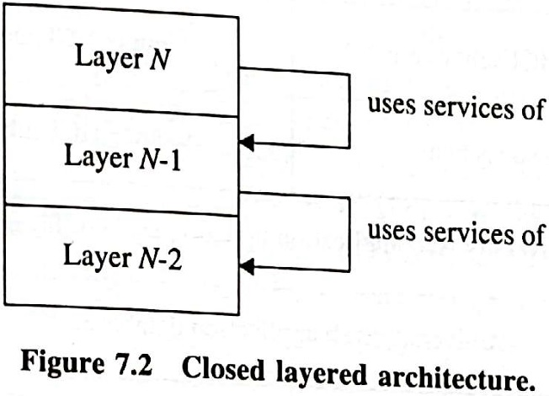

Slide 5
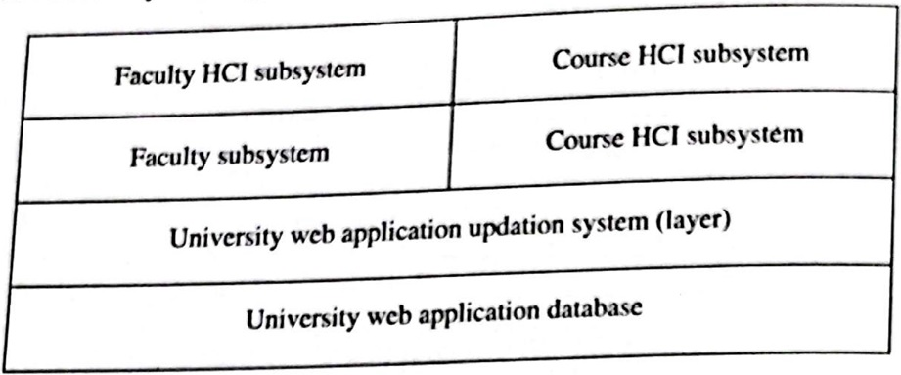
Partitioning

Slide 6
Generic Architectural Framework
MVC, or Model-View-Controller, is a software Architectural Framework that organizes code into three interconnected components:
Model: Represents the data and business logic. It handles data retrieval, storage, and manipulation, ensuring that the application functions correctly.
View: The user interface or presentation layer. It displays data from the model and sends user inputs to the controller.
Controller: Acts as an intermediary between the model and the view. It processes user input, updates the model, and determines which view to display.

Slide 7
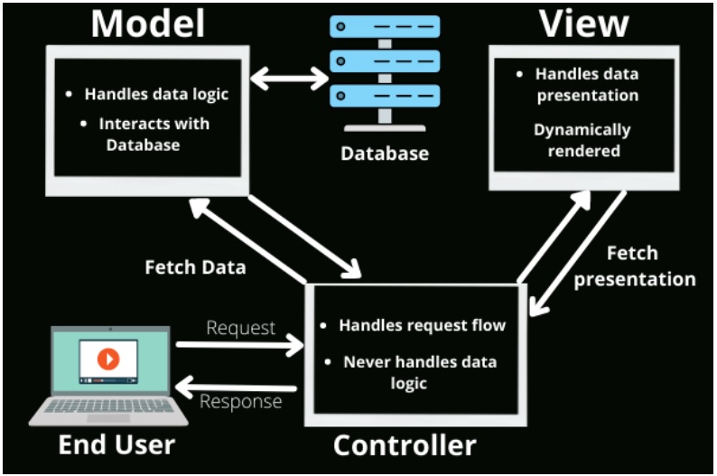

Slide 8
Specific Architectural Framework
Gives you implementation-specific skeleton
Consists of reusable design patterns in a defined architecture
Architectural Framework improves code organization, scalability, and maintainability by separating concerns, making development more efficient.
Example: Laravel, Ruby on Rails etc.

Slide 9
